Slide 1



Department of Computer Science and Engineering
Detecting Cyberbullying Text Using TF-IDF Vectorization and Support Vector Machine Classification
V Karthick
Associate Professor
Department of Computer Science and Engineering
Presented by
Vaishnavi C(210701298) Vaishnavi Sri S.M(210701299)

Slide 2
ABSTRACT
Cyberbullying is a prevalent form of harassment in India. It encompasses various behaviors that degrade human body features and sentiments in every conceivable way. Victims of cyberbullying often experience psychological distress such as depression and agitation. To address this issue, we have developed a website capable of detecting cyberbullying based on factors such as generation, cultural background, gender identity, and faith. The ML model we have used here is SVM, which classifies texts and makes predictions on test data with the help of TF-IDF. TF-IDF converts text into numerical values to fit the data into the training model. Additionally, in the preprocessing of the data, NLTK is used to convert the text into base forms to classify the data into the categories above.
Keywords - Cyberbullying detection , SVM , NLTK ,
TF-IDF.
﻿

Slide 3
INTRODUCTION
Cyberbullying detection holds extreme importance in our environment as it serves as a protector against social media harassment. Cyberbullying is timeless; it can happen over any period of time and easily hurt the feelings of the victim. In our approach, we employ Support Vector Machine (SVM), a powerful algorithm for text classification. SVM analyzes features like word frequency and language characteristics to determine whether a given text contains cyberbullying content. TF-IDF assigns weights to terms, emphasizing rare words and downplaying common ones. This technique ensures computational efficiency and scalability.Additionally, we utilize the Natural Language Toolkit (NLTK) for tokenization, lemmatization, and stemming. NLTK enhances data quality by converting words to their base forms, contributing to effective modeling.

Slide 4
LITERATURE SURVEY
SNO | TITLE | AUTHOR | JOURNAL | YEAR PUBLISHED | CONTRIBUTION
1 | SVM-based Deep Stacking Networks | J. Wang and J. Wu |  | 2019 | Utilizes SVM-based deep stacking networks for text classification
2 | Contextualized Word Embeddings for Cross-Domain Text Classification Using Transfer Learning | M. Hadjar, M. Hadhoud, and Y. Elkhatib | Not specified | 2021 | Explores contextualized word embeddings in cross-domain text classification

Slide 5
s.no | TITLE | AUTHOR | JOURNAL | YEAR PUBLISHED | CONTRIBUTION
3 | An Improved Detection of Cyberbullying on Social Media Using Machine Learning Algorithms | Editorial Board | Journal of Social Media Studies | 2023 | Executed various machine learning algorithms (including SVM) on a benchmark cyberbullying-representations dataset from Twitter. SVM outperformed the baseline score after randomized oversampling.
4 | Automated Text Analysis for Political Sentiment Using Machine Learning | Y. Gu | Political Communication Research | 2019 | Aims to understand public opinion and trends by analyzing large volumes of political texts efficiently.
5 | A Novel Radiomics-Based Technique for Identifying Cardiovascular Diseases | E. Karaca, A. Özyer, S. Demirci, and C. Aydın, |  | 2024 | This study proposes a new technique that uses radiomics, a field that extracts a large number of features from medical images, to identify cardiovascular diseases. The approach aims to enhance the diagnosis and treatment.

Slide 6
SNO | TITLE | AUTHOR | JOURNAL | YEAR PUBLISHED | CONTRIBUTION
6 | Hybrid Approaches for Sentiment Analysis Combining TF-IDF and Deep Learning | Kumar, S. Verma, and P. Singh | Journal of Sentiment Analysis | 2023 | Presented hybrid methods merging TF-IDF and deep learning for sentiment analysis. Aims to capture nuances of sentiment in texts, improving analysis effectiveness.
7 | Application of SVM in Biomedical Text Mining | L. Zhang and K. Zhou | Journal of Biomedical Informatics | 2023 | Discussed SVM application in biomedical text mining, extracting meaningful information from biomedical literature to enhance research and discovery.
8 | Leveraging NLTK for Improved Text Mining in Medical Research | R. Fernandez, C. Rios, and M. Gomez | Journal of Medical Text Mining | 2023 | Examined NLTK use for text mining in medical research, improving extraction and analysis of information from medical texts.

Slide 7
SNO | TITLE | AUTHOR | JOURNAL | YEAR PUBLISHED | CONTRIBUTION
9 | Enhancing NLP Models Using SVMs for Text Classification | M. Smith, J. Brown, and L. Wilson | Journal of Natural Language Processing | 2022 | Explored how SVMs can improve Natural Language Processing (NLP) models for text classification, enhancing accuracy in classifying various text types.
10 | Combining TF-IDF and Machine Learning for Efficient Document Classification | T. Nguyen and B. Tran | Journal of Document Classification and Information Retrieval | 2024 | Proposed combining TF-IDF with machine learning for efficient document classification, leveraging strengths of both techniques.

Slide 8
EXISTING SYSTEM
Cyberbullying detection systems utilizing Convolutional Neural Networks (CNN) and Long Short-Term Memory (LSTM) networks combine the strengths of both architectures to enhance detection accuracy. CNNs excel at capturing local features and patterns within the text, while LSTMs are adept at understanding long-term dependencies and contextual information. In a typical workflow, text data from social media is preprocessed (cleaning, tokenization), transformed into word embeddings, and then processed through CNN layers to extract features. These features are passed through LSTM layers to capture sequential dependencies before final classification. This hybrid approach has shown promising results, with studies reporting accuracies ranging from 70% and 80%, although challenges such as handling imbalanced datasets and detecting nuanced language persist【28†source】【29†source】.

Slide 9
PROPOSED METHODOLOGY
Data Preparation and Cleaning:
Import necessary libraries for data manipulation, NLP, and ML.
Load the dataset (e.g., cyberbullying_tweets.csv) into a Pandas DataFrame.
Clean the data by removing stop words, punctuation, URLs, and numeric values.
Tokenize the text and apply stemming and lemmatization.
Encoding Labels:
Encode the target variable (e.g., cyberbullying_type) into numerical values using LabelEncoder.
Train-Test Split:
Split the preprocessed text data into training and testing sets using train_test_split.

Slide 10
PROPOSED METHODOLOGY
Feature Extraction with TF-IDF:
Use TfidfVectorizer to convert text data into numerical feature vectors.
Transform the preprocessed text into a matrix of TF-IDF features.
Support Vector Machine (SVM) Model:
Train an SVM model with a linear kernel using the training set.
SVM efficiently handles high-dimensional text data.
Model Evaluation:
Calculate the model’s performance on the test set (e.g., accuracy).

Slide 11
PROPOSED METHODOLOGY
Reusability and Deployment:
Save the trained SVM model and TF-IDF vectorizer to disk using pickle.
Enable reusability without re-tutoring for future predictions.
Custom Input Prediction:
Create a function (custom_input_prediction) to predict cyberbullying type for new text inputs.
Preprocess input text using the saved TF-IDF vectorizer.
Apply the loaded SVM model to make predictions.
Map numerical predictions back to correct labels.
Practical Application:
The trained model can be used to identify cyberbullying in real-world scenarios.

Slide 12
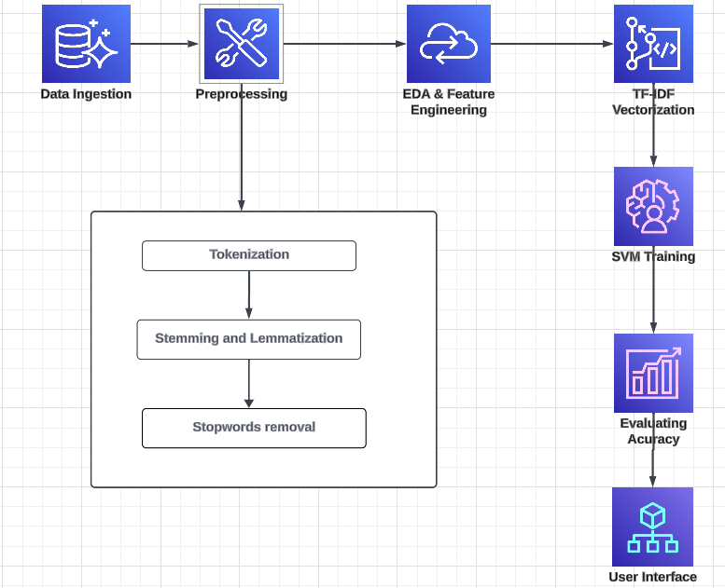
PROPOSED METHODOLOGY

Slide 13
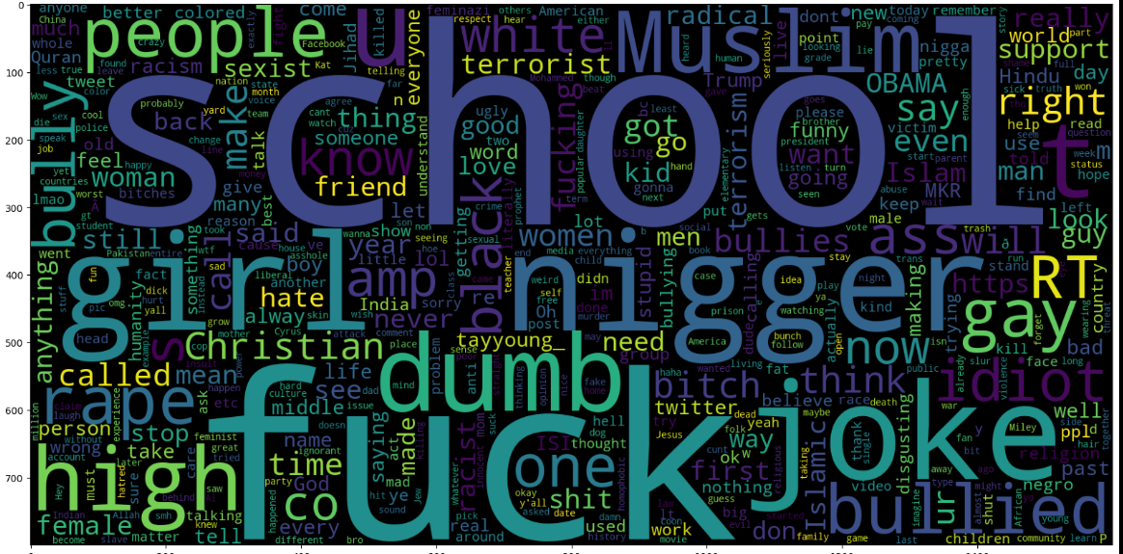
WORD CLOUD
Fig.1 Word Cloud

Slide 14
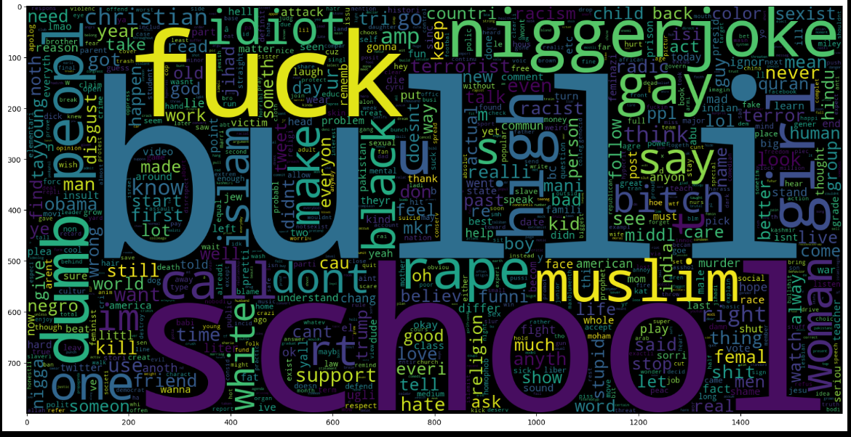
WORD CLOUD
Fig.2 Word Cloud

Slide 15
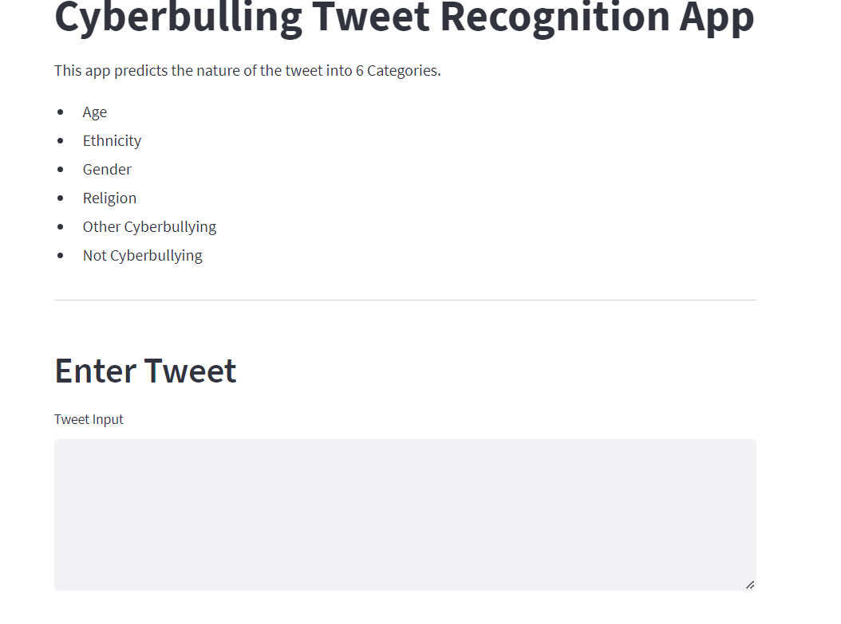
RESULT AND DISCUSSION

Slide 16
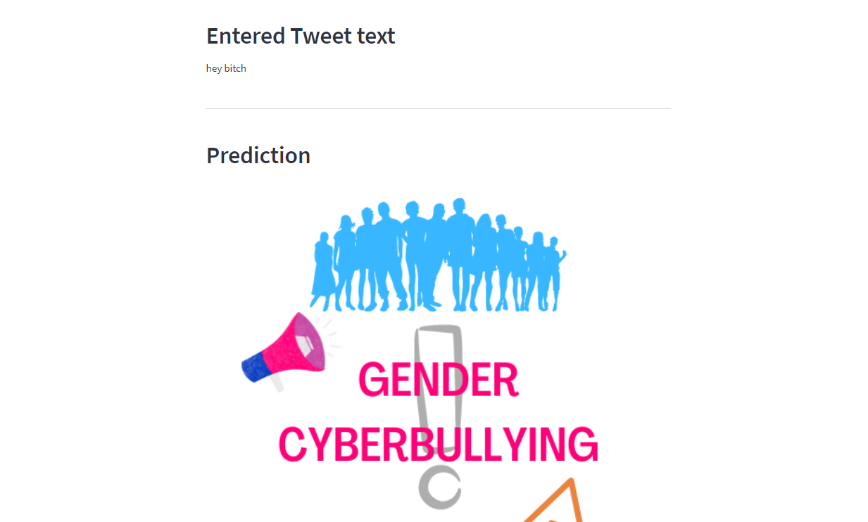
RESULT AND DISCUSSION

Slide 17
CONCLUSION & FUTURE WORK
Our cyberbullying detection model, utilizing a Support Vector Machine (SVM) and Natural Language Toolkit (NLTK), achieves an impressive 82% accuracy. This model represents a significant step in combating online harassment by automatically identifying offensive content. Its user-friendly, text-based approach ensures practicality and immediate applicability. Future work includes exploring ensemble methods with decision trees, integrating the model into social media platforms, and extending its capabilities to process images and audio for more comprehensive cyberbullying detection.

Slide 18
REFERENCES
[1] J. Wang and J. Wu, "SVM-based Deep Stacking Networks," 2019.
[2] M. Hadjar, M. Hadhoud, and Y. Elkhatib, "Contextualized Word Embeddings for Cross-Domain Text Classification Using Transfer Learning," 2021
[3] E. Karaca, A. Özyer, S. Demirci, and C. Aydın, "A Novel Radiomics-Based Technique for Identifying Cardiovascular Diseases," 2024. [4] Y. Gu, "Automated Text Analysis for Political Sentiment Using Machine Learning," 2019. [5] Editorial Board, "Coronary Artery Disease: Current Research and Future Directions," 2024.

Slide 19
REFERENCES
[6] M. Smith, J. Brown, and L. Wilson, "Enhancing NLP Models Using SVMs for Text Classification," 2022. [7] A. Kumar, S. Verma, and P. Singh, "Hybrid Approaches for Sentiment Analysis Combining TF-IDF and Deep Learning," 2023.
[8] L. Zhang and K. Zhou, "Application of SVM in Biomedical Text Mining," 2023.
[9] R. Fernandez, C. Rios, and M. Gomez, "Leveraging NLTK for Improved Text Mining in Medical Research," 2023.
[10] T. Nguyen and B. Tran, "Combining TF-IDF and Machine Learning for Efficient Document Classification," 2024.

Slide 20
Thank You

